Slide 1

Tanzania water Well
Our children depend on clean reliable water wells

Slide 2

Problem statement
Amongst many other hardships, DEVELOPING NATIONS TEND TO SUFFER FROM POVERTY, MALNOURISHMENT, and LACK OF EDUCATION
The purpose of this model is to accurately predict functional water wells, to support the ability of locals to obtain clean running water.

Slide 3

Business value
Humanitarian
Identify water well features that have higher probability of functionality for future projects
To increase water availability in areas of need
Increase longevity and reliability of water wells

Slide 4

methodology
Analysis of current water well data to understand key features of functioning wells
Some of the key features explored include:
Source of water
payment of water well
Age of water well
region

Slide 5

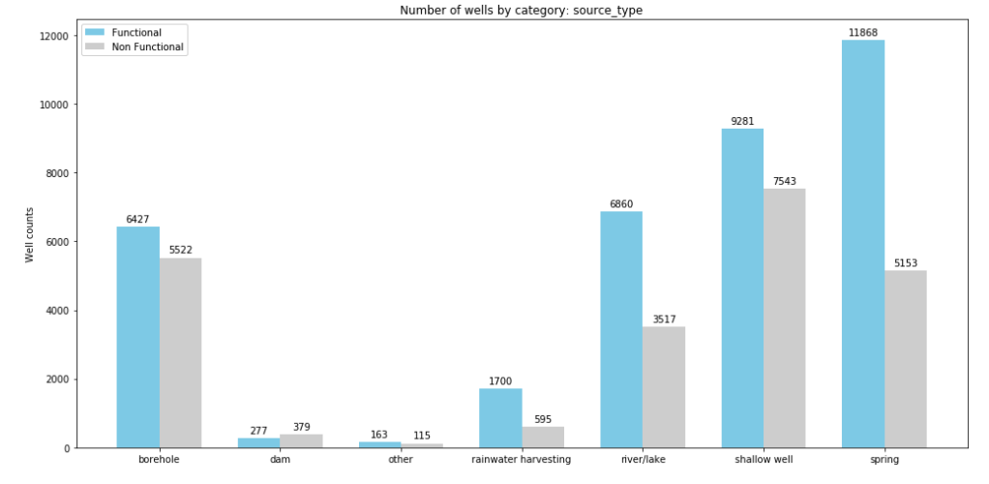
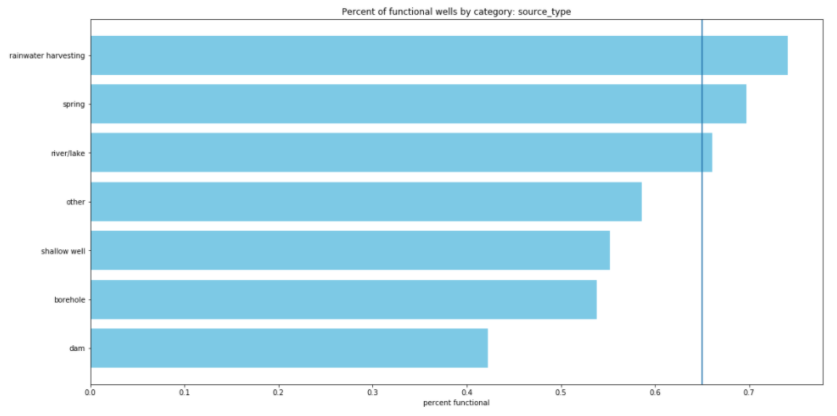
Water source
Rainwater harvesting
Spring
River / Lake

Slide 6
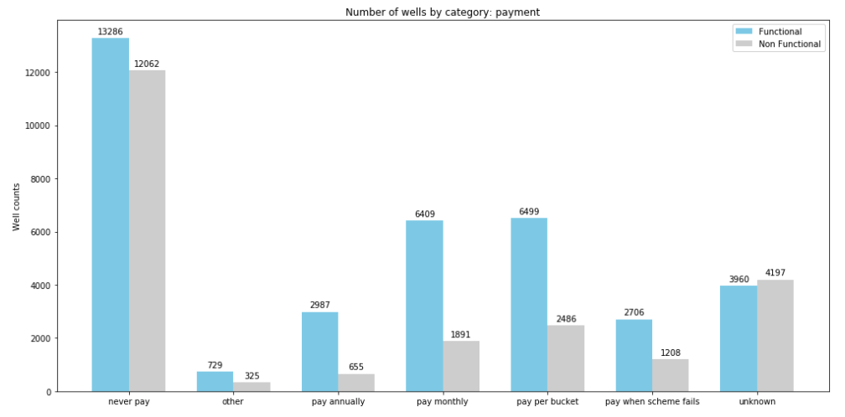
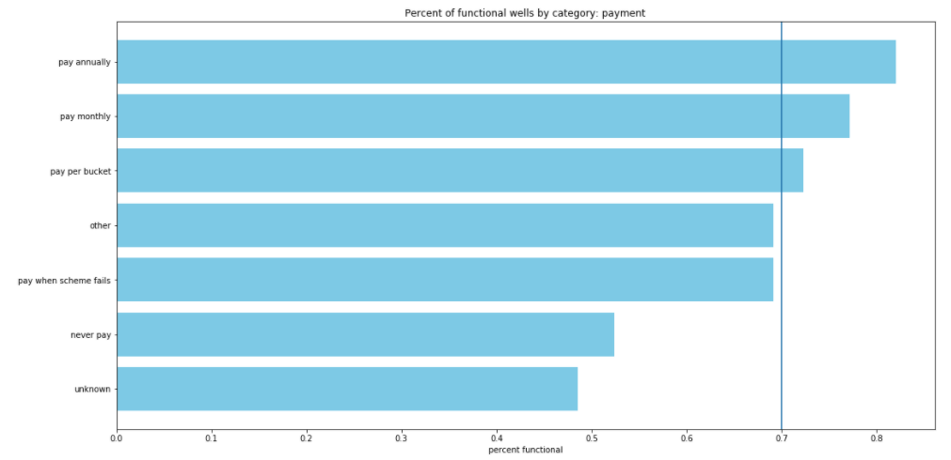
payment
Annually
Monthly
Per bucket

Slide 7
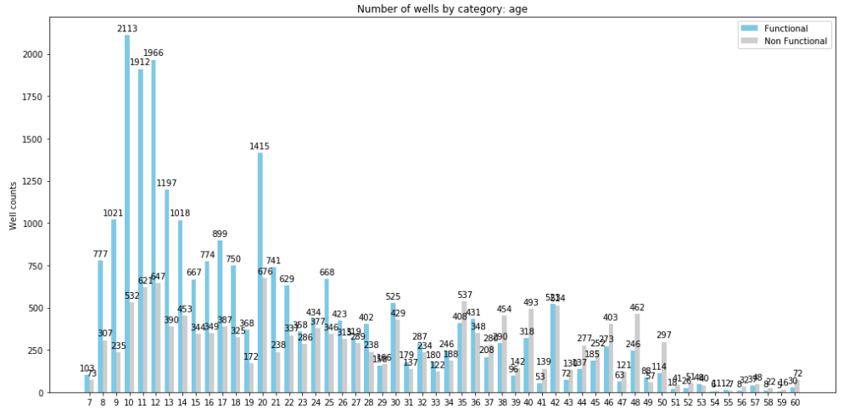
Age

Slide 8
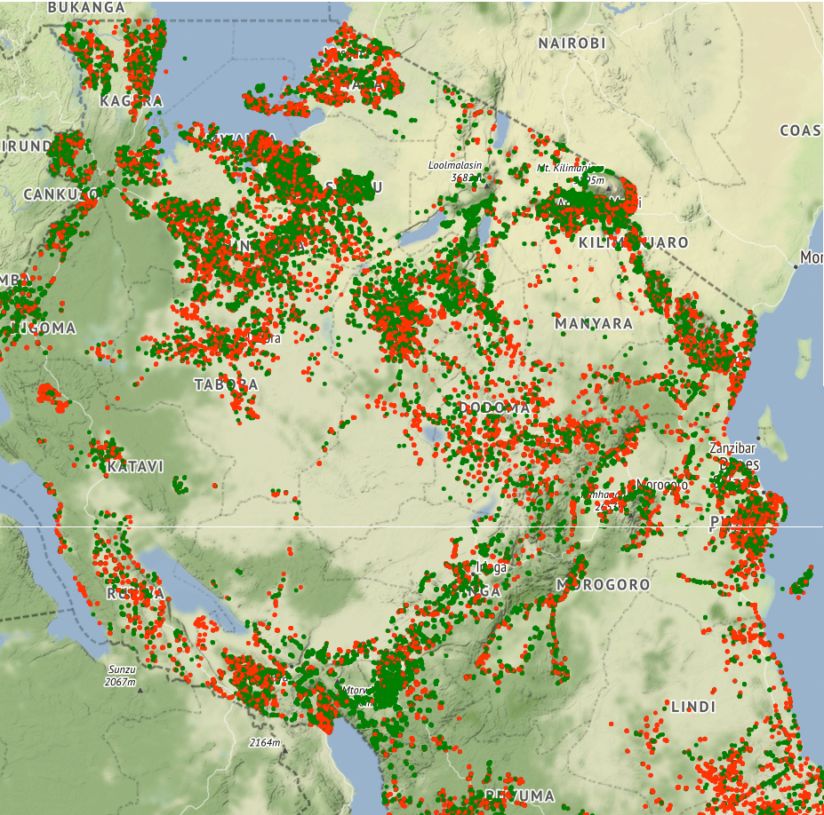
region

Slide 9
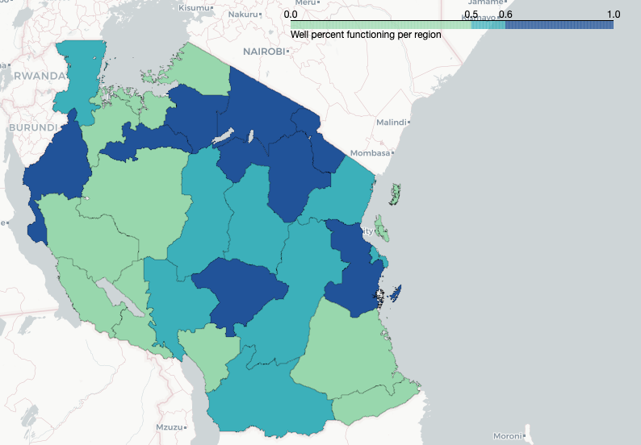
Water well reliability per region

Slide 10
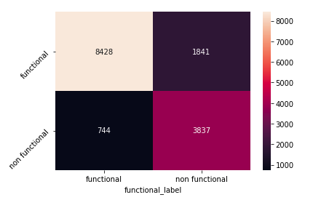
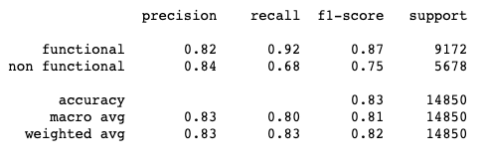
results
XGBoost model used to predict functioning water wells
Training set score for SVM: 0.838361
TestinG set score for SVM: 0.825926
CONFUSION MATRIX
High Functional recall of 0.92!

Slide 11
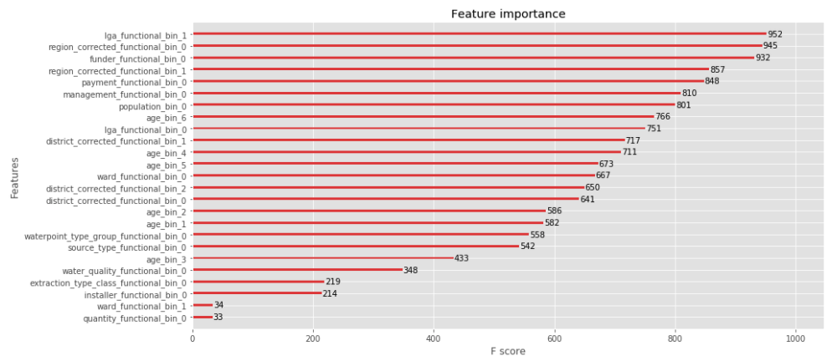
summary
top key features used to determine if a water well if functional are:
Lga
Region
Payment
Management
Population
age

Slide 12

Future considerations
Improving model accuracy:
Introducing external data to the dataset
City data - location, population
Region poverty data
Natural disaster data – earthquakes, floods, droughts
Multiclassification model:
To provide future finance allocation by predicting timeframes a well may require repair
For increased success of future construction projects

Slide 13
Thank you

